Slide 1


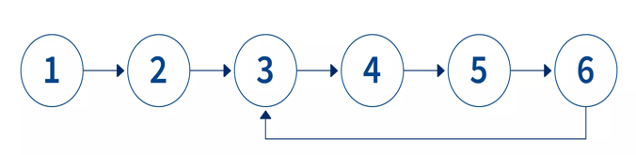

LINKED LIST
A linked list is a collection of nodes unlike arrays, which use a contiguous block of memory. This structure allows for efficient insertion and deletion of elements at any position within the list but may result in slower random access times.
Each node in a linked list contains two fields:
Data: This field stores the actual data or values you want in the list.
Next (or Link): This field contains a reference (a pointer or link) to the next node in the sequence
Head: The head of the linked list refers to the first node in the list. It is the starting point for traversing the list.
Tail: In some cases, linked lists may have a tail pointer, which refers to the last node in the list.

Slide 2
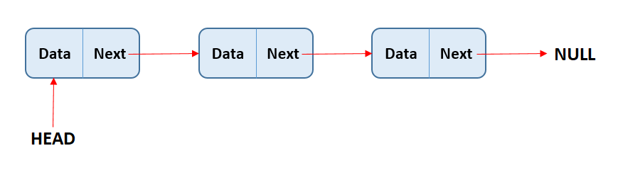
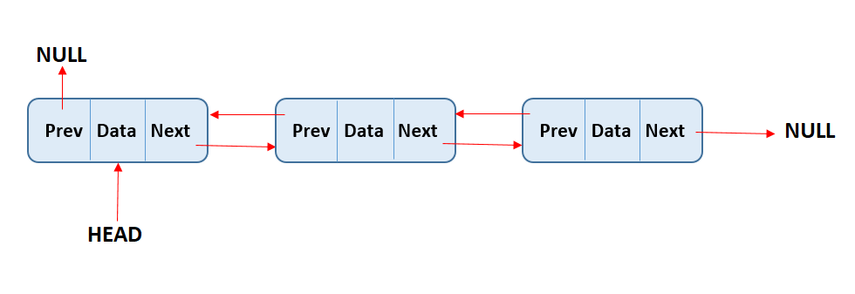
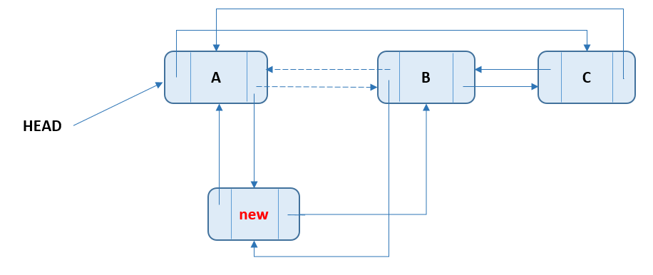
Types
Singly Linked List: Each node has a reference to the next node in the list. Traversal can only be done in one direction
Doubly Linked List: Each node has references to both the next and the previous nodes in the list. This allows for bidirectional traversal but requires more memory.
Circular Linked List: the tail points back to the head, forming a closed loop. It can be either singly or doubly linked.

Slide 3
LOOP DETECTION
Algorithm
Pseudocode
1. Initialize two pointers, slow and fast, both pointing to the head of the linked list.
2. Traverse the linked list using the slow and fast pointers.
3. Move the slow pointer one step at a time and the fast pointer two steps at a time.
4. If there is no loop in the linked list, the fast pointer will eventually reach the end (become null) because it moves faster than the slow pointer. In this case, return "No Loop Detected.“
5. When the fast pointer equals the slow pointer, return "Loop Detected."
function detectLoop(head):
slow = head
fast = head
while fast != null and fast.next != null:
slow = slow.next
fast = fast.next.next
if slow is equal to fast:
return "Loop Detected”
return "No Loop Detected"

Slide 4
Floyd’s Detection
Algorithm:
In this approach, we use two pointers - one slow (tortoise) and one fast (hare).
The slow pointer moves one step at a time while the fast pointer moves two steps at a time.
If there is a loop in the linked list, the fast pointer will eventually catch up to the slow pointer.
If there is no loop, the fast pointer will reach the end of the list.
Time Complexity: O(n) - Linear time complexity, where n is the number of nodes in the linked list.
Space Complexity: O(1) - Constant space complexity, as it uses a fixed amount of additional memory regardless of the size of the linked list.
Hashmap vs Floyd’s Detection
Detecting a loop in a linked list using a HashSet has a time and space complexity of O(n) due to the need to store all visited nodes, while Floyd's Cycle Detection has a time complexity of O(n) and a space complexity of O(1) as it uses two pointers, making it more memory-efficient for large lists.

Slide 5
import java.util.*;
public class Main{
public static void main(String[] args){
Scanner sc=new Scanner(System.in);
String str=sc.nextLine();
String[] arr=str.split(" ");
Set<String> set=new HashSet<>();
for(String a: arr) {
if(!set.add(a)) {System.out.print("Loop");break;}}
}}

Slide 6
Hashing approach
Hashing in loop detection involves using a hash function to map unique identifiers (memory addresses) of visited nodes to distinct values in a data structure (HashSet).
While traversing the linked list, you store references to visited nodes in a HashSet. If you encounter a node that's already in the HashSet, you've detected a loop. Otherwise, you continue traversing.
Algorithm:
In this approach, we use a HashSet to store the references of nodes as we traverse the linked list.
If we encounter a node whose reference already exists in the HashSet, it means there is a loop in the linked list.
Otherwise, we continue traversing the list until we reach the end.
Time Complexity: O(n) where n is the number of nodes in the linked list.
Space Complexity: O(n) for the HashSet to store the visited nodes.

Slide 7
INTERVIEW QUESTIONS
5. Explain how you would remove a loop in a linked list.
To remove a loop in a linked list, you can use Floyd's Cycle Detection to find the meeting point of the two pointers. Then, reset one pointer to the head and move both pointers one step at a time until they meet again. The point where they meet is the starting node of the loop. Set the `next` of the previous node to null to break the loop.

